Slide 1
Macro Economics
Macro Economics studies the economy as a whole and not as a individual unit.
It focuses on aggregate factors such as unemployment, growth. National income,GDP, and inflation etc.

Slide 2
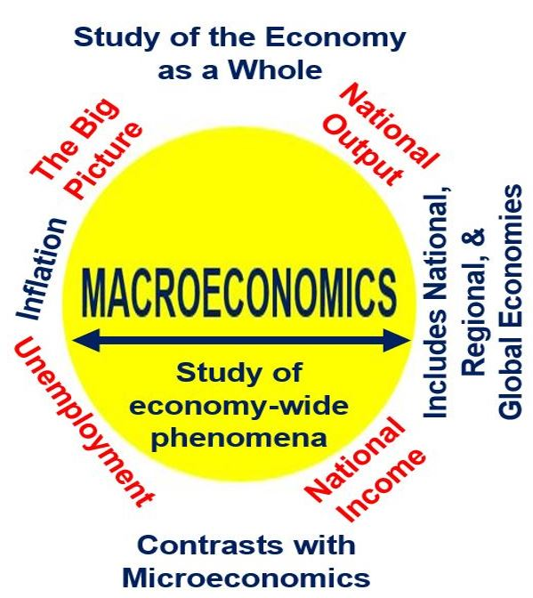

Slide 3
Features of Macro Economics
Study Of Aggregates
Macro Economics studies the aggregates and not individual units. It involves relation between economic aggregates such as national income, aggregate demand, aggregate supply, unemployment, inflation etc.

Slide 4
Features
Lumping Method
It Splits up the economy in big chunks (Individual Household and Individual Firms) then studies the aggregate measures such as Aggregate Demand, supply and price level etc.

Slide 5
Features
Policy Oriented
Analysis of Macro Economics is policy oriented. These policies help in generating employment. Macroeconomic policy focuses on limiting the effects of the business cycle to achieve the economic goals of price stability, full employment, and growth

Slide 6
Features
Gives an overall view of economy
It gjves the big picture of economy. The study of macroeconomics gives an overall view of the economy. It interlinks various aggregates so as to show the inter-relationships between them.it tend to provide a more realistic view of the overall economy.

Slide 7
Features
General Equilibrium Analysis
Macroeconomics is concerned with the behaviour of aggregates and their interdependence. It is a general equilibrium analysis in which everything depends on everything else. For instance, a change in income level may results in change in savings, which in turn may influence investment.

Slide 8
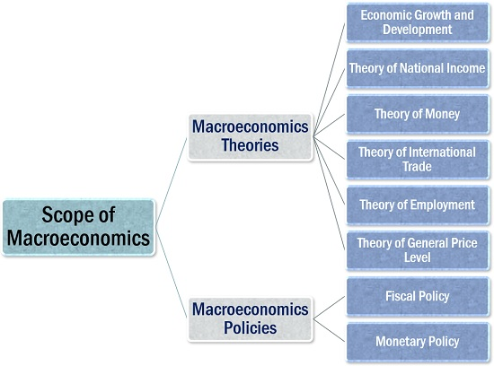
Scope of Macro economics

Slide 9
Economic Growth and Development: The status of a country’s economy can be evaluated in terms of the per capita real income, as studied under macroeconomics.
Theory of National Income: It covers the various topics related to the evaluation of national income, including the income, expenditure and budgeting.
Theory of Money: Macroeconomics analyzes the functions of the reserve bank in the economy, the inflow and outflow of money.
Theory of Employment: This stream of macroeconomics helps to figures out the level of unemployment and prevailing employment conditions in the country.
Theory of General Price Level: The most important of all is the analysis of product pricing and how these price levels fluctuate because of inflation or deflation.

Slide 10
The government and the reserve bank functions together while determining the macroeconomic policies, for the nation’s welfare and development. The policies of Macro ecomics are :-
Fiscal Policy: fiscal policy is a means of meeting the deficit of income over the expenditure; it is a form of budgetary decision under macroeconomics.
Monetary Policy: Monetary policy is framed by the reserve bank in collaboration with the government. These policies are the measures taken to maintain economic stability and growth in the country by regulating the various interest rates.

